Slide 1
Acid and bases
Science Explorer
2/15/2023

Slide 2
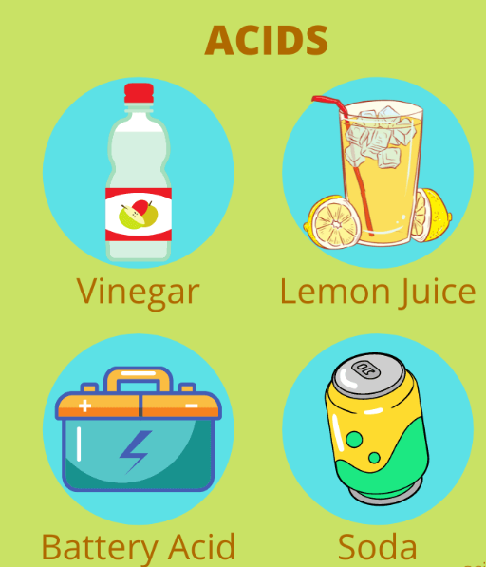
What are acids?
Taste sour
Produce H+ in water
PH is less than 7
Examples:
Stomach acid (hydrocholric acid)
Lemon (citric acid)
Vinegar (acetic acid)
Tomato (oxalic acid)

Slide 3
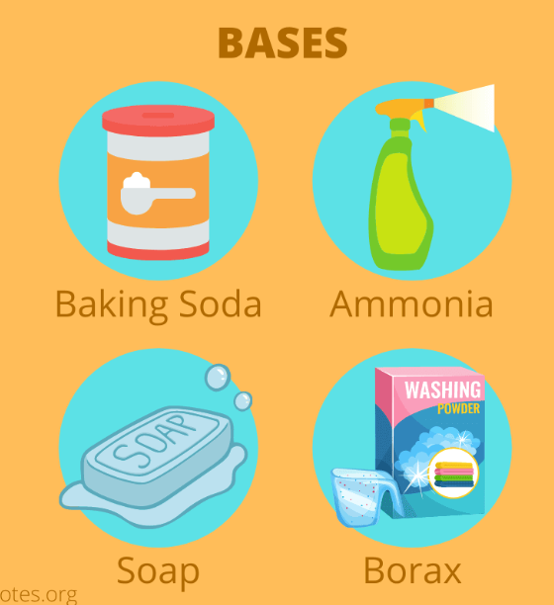
What are bases?
Taste Bitter
Produces hydroxide ions OH- in water
PH is higher than 7
Examples
Liquid soap (potassium hydroxide)
Baking soda (sodium bicarbonate)
Detergens (sodium hydroxide)
Egg

Slide 4
PH Scale
pH is a measure of how acidic/basic water is.
The range goes from 0 - 14, with 7 being neutral. pHs of less than 7 indicate acidity, whereas a pH of greater than 7 indicates a base.
pH is really a measure of the relative amount of free hydrogen and hydroxyl ions in the water

Slide 5
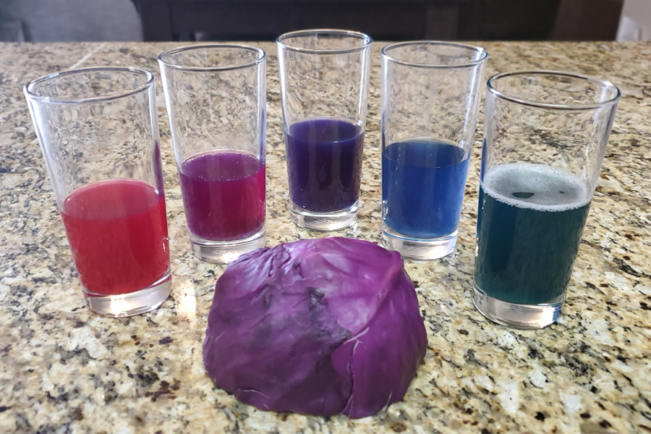
Red cabbage pH indicator
Red cabbage contains natural chemicals, called anthocyanins, that can be used as an indicator.

Slide 6
Red cabbage pH indicator
When you pour red cabbage indicator into an ACID it turns RED/PINK
When you pour red cabbage indicator into a BASE it turns BLUE/GREEN

Slide 7
Part 1: Acid Test
Investigate which drink is most ‘acidic’
Taste each drink: which one is most sour? Vinegar, lemon, grapefruit, tomato
Does sourness have association with acidity?
Rank your drinks to most acidic to least acidic
Test with cabbage water indicator
Look at th color change and assess acidity. Is your guess correct? Which is more acidic?
Test with pH strip
SAVE the vinegar cup!

Slide 8
Part 2: Base Test
Investigate which drink is most ‘basic’
DO NOT TEST BASIC : detergents, baking soda, egg white
Optional: what do they feel like?
Guess which one you think would be a stronger/weaker base
Test with cabbage water indicator
Look at th color change and assess how basic each substance is. Is your guess correct? Which is more basic?
Test with pH strip
SAVE the baking soda cup!

Slide 9
Part 3: Neutralization
How would you make your acidic/ basic solution more neutral?
Is there a benefit to neutralization?
i.e) You have acid reflux -> you need to reduce acidity of your digestive enzyme
Take antacid like tums!
What would happen?
Question) How would you neutralize a basic substance based off of what we discussed?
Add…?
Test this using the baking soda cup

