Slide 1
Flowers and Pollination
Science Explorers
Spring 2023

Slide 2
Anatomy of Flower

Slide 3
What is Pollination?

Slide 4
Pollinators

Slide 5
Pollinators

Slide 6
Pollinators

Slide 7
Pollinators

Slide 8
Pollinators

Slide 9
Activity 1: Dissect and figure out the anatomy of flowers

Slide 10
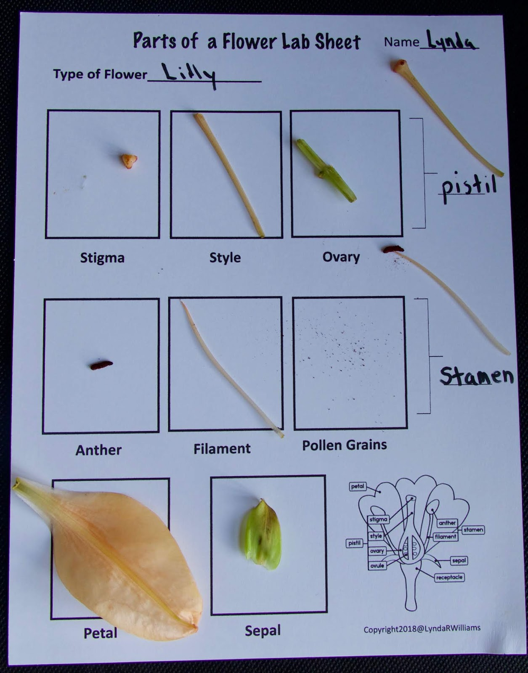
Activity 1: Dissect and figure out the anatomy of flowers
Pull off sepals - IF there is one!
Peel back petals
Have the kids point out the anther, stamen, pistil, style, etc.
If you pluck a stamen and cut open the anther (you may need a razor blade, you should do this for the kids!) you can actually see some pollen
Pluck the pistil and open it. Can you see the ovaries/eggs?

Slide 11
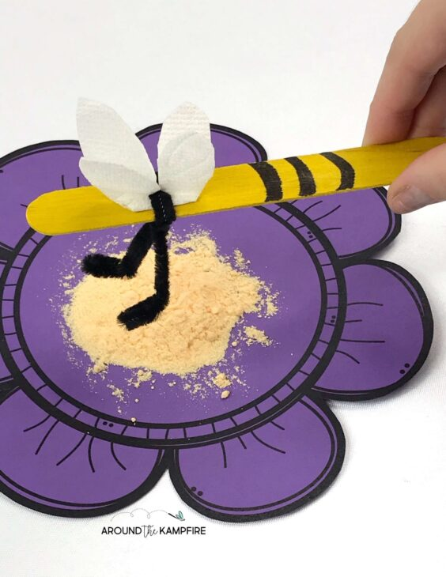
Activity 2: Pollination demonstration
Make a Bee Pollinator using popsicle stick, pompoms and pipe cleaners (You can give them wings and eyes if you want!)
Make your flowers by drawing in your disposable plates
Create your pollen using Cheese Doodles
Help your bees pollinate the flower
Lesson adapted from: https://blog.kaplanco.com/ii/pollination-steam-craft

Slide 12
Activity 3: Pollinator/flower adaptation activity (Optional)
Look through the Pollinator cards and figure out the details for each pollinator
Figure out which flowers may be pollinated by which pollinators
DIscuss why the flowers were matched to specific pollinators

