Slide 1
Greenhouses and Seed Planting

Slide 2
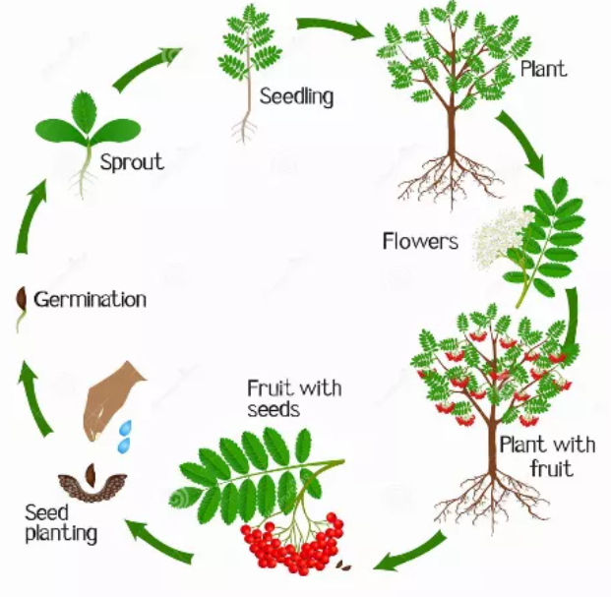
Flowering plant life cycle
Germination is activating a seed’s growth by adding water
Leaves turn water, air, and the sun’s energy into sugar using chloroplasts, which is what makes them green
Flowering plants either pollinate themselves or other plants of the same species
Pollinated flowers become fruits with seeds

Slide 3
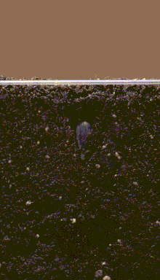
Seeds and Germination
Seeds and Germination Explained - YouTube

Slide 4
Greenhouses
Clear structures used to grow plants
Why do people use them?
Controlled conditions
Temperature
Humidity
Lighting
Grow plants out of season
Grow plants that wouldn’t survive outdoors where you live

Slide 5
Today’s activity: Build greenhouses and design your own plant-growing experiment!
In three groups…
Part 1: Brainstorm and select an idea for your plant-growing experiment(s)
Part 2: Write experimental instructions
Part 3 (optional): Build greenhouse(s) for your experiment
Part 4: Following your experimental design, plant and water your seeds throughout the few weeks

Slide 6
Part 1: Brainstorm and select an idea for your plant-growing experiment(s)
Figure out what experimental question(s) you want to answer
Examples:
Which type of seed germinates most quickly?
How much water makes beans sprout faster or grow taller?
Does germination happen more quickly in the light or in the dark?
How does soil depth affect germination and growth speed?
Record your question(s) on the worksheet

Slide 7
Part 2: Write experimental instructions (protocol)
Important considerations:
What do seeds need to germinate?
Water
Air
Warmth
What do plants need to grow?
Air
Water
Sun
Soil (for roots to absorb nutrients and water)
Record your protocol on the worksheet

Slide 8
Instruction (protocol) tips
Recommendations:
Read the instructions and the back of the seed packet
Recommends how far apart to space seeds and how deep to plant them
Can be modified, especially if that’s part of the experiment (for instance, if you’re testing the effects of seed depth on plant growth)
Make sure you are only changing the condition that you want to test
We want to keep everything except the independent variable the same (seed depth, amount of water, etc.) to make sure that the condition we’re testing is causing the change we see in the dependent variable (plant height, root size, time to germination, etc.)
Consider using replicates
In most of science, and especially in biology, there’s a lot of natural variability
To make sure that changes in the dependent variable aren’t from random chance, we do the same experiment multiple times to make sure we get the same answer (replicates)

Slide 9
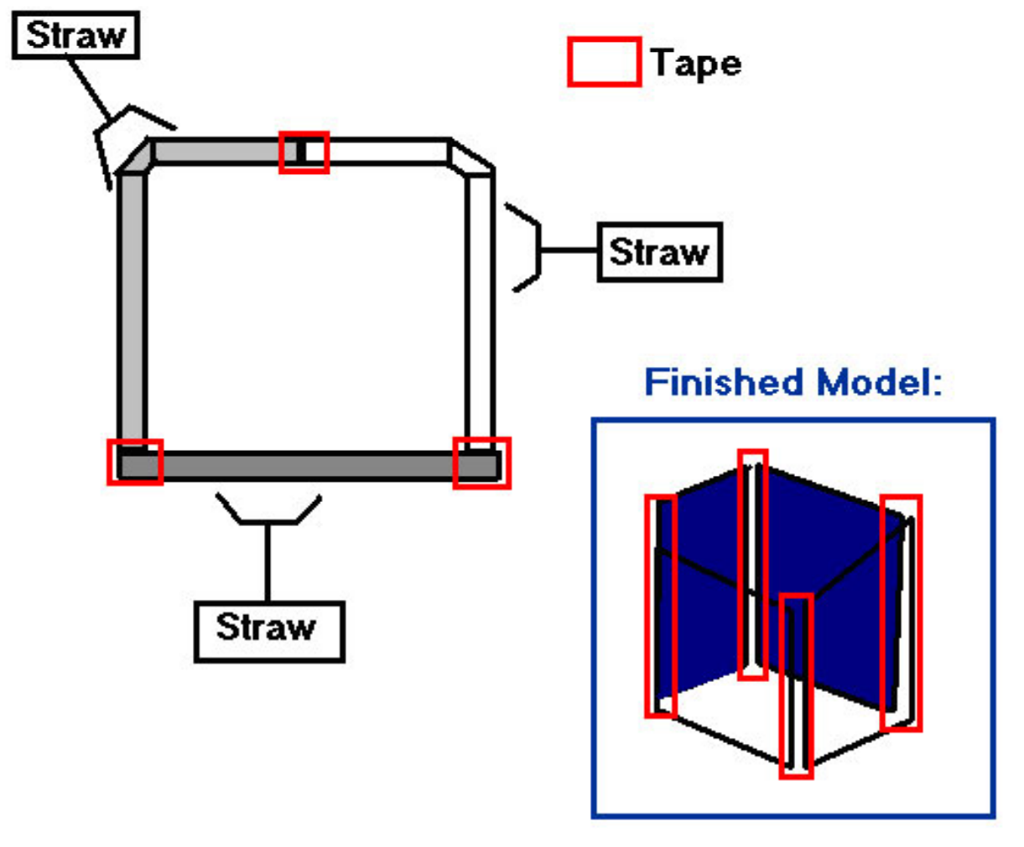
Part 3 (Optional): Build greenhouses
If you want to use a greenhouse in your experiment (or just build one for fun!):
1. Make 4 sides from bendy straws, regular straws, and tape (top left picture)
2. Tape the four sides together (bottom right picture)
3. Cover the sides and the top of the cube with plastic wrap
4. Add features to your greenhouse
Examples:
Holes for air flow
More plastic wrap to increase heat retention
Paper to block out light
You can also make multiple greenhouses to test how different constructions affect plant growth!

Slide 10
Part 4: Plant and water your seeds and perform your experiment(s)!
Plant and water your seeds according to your protocol
Decide on a schedule for who is going to water the seeds/plants according to your instructions
Fill out the dates, initials of the person doing the task, and what the person will do to care for the plant on the worksheet
Check on the seeds daily
Record any changes you observe in the notes section of the worksheet
Note: If you plant some of the seeds against the glass then you can observe the germination process!

