Slide 1
Science Explorers
WEEk 1 of Engineering!

Slide 2
What is “Engineering”?
Introduction to Engineering

Slide 3
We always begin with a need →
Engineering Design Process

Slide 4
Design Process
Guidelines to Brainstorming

Slide 5
Guidelines to Brainstorming
Do
Don’t
Have fun
Encourage wild ideas!
Write all ideas down
Stay focused
Build on your teammate's ideas
Get discouraged
(Provide only positive)
Talk over your teammates
(Do hold only 1 conversation at a time)

Slide 6
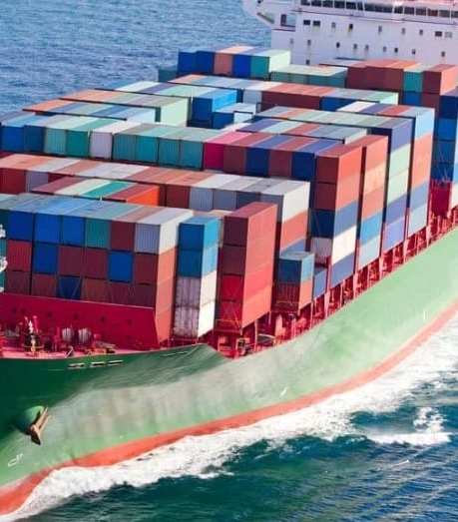
How do boats float?!?

Slide 7
$$Density= \frac{Mass}{Volume}$$
Fixed Densities:
Water = 1.0 g/mL
Aluminum = 2.6 g/mL

Slide 8
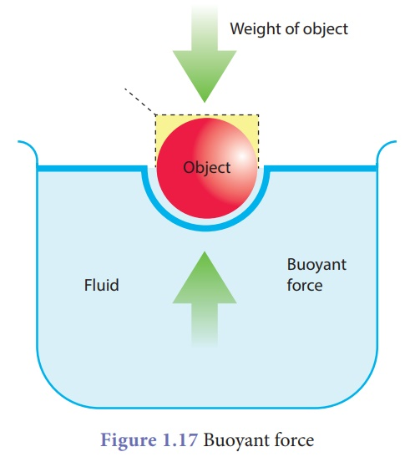
Air = 0.001 g/mL
Water = 1.0 g/mL
Density (g/mL)

Slide 9
Float your boat!
Have fun
Make positive comments
Encourage wild ideas!
Write all these wild ideas down
Stay focused
Build on your teammate's ideas

