Slide 1
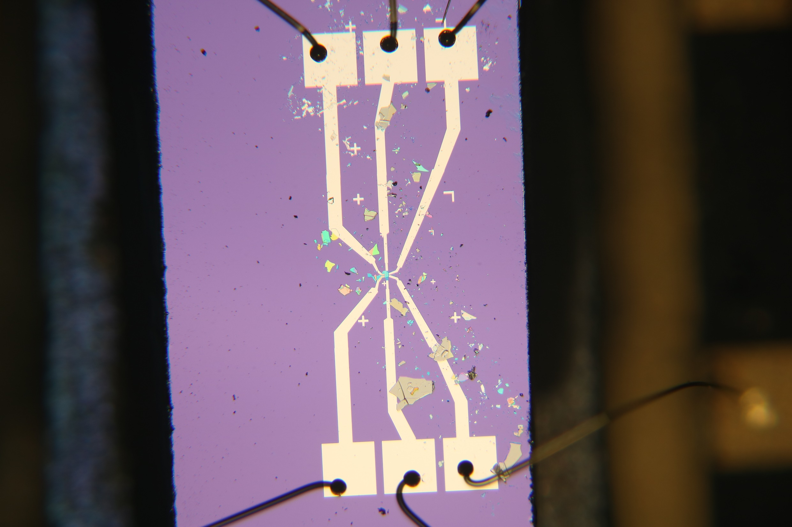

Slide 6
Thickness of human hair!

