Slide 1
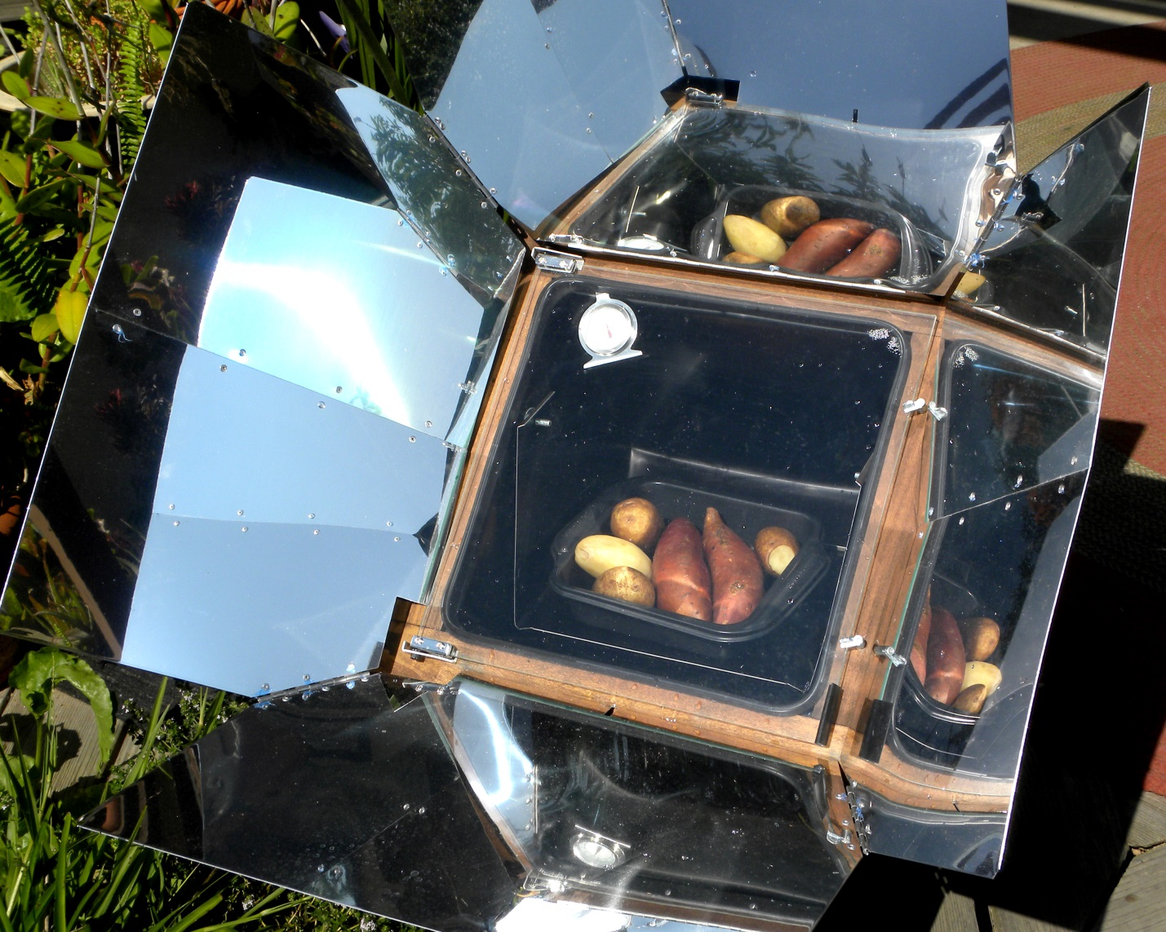
Different part of a solar oven
Light collectors (mirrors)
Light-heat converter: Inside is black-absorbs light and converts it to heat.
Heat trapper: Light can get in through window, but oven is sealed so hot air cannot get out.

Slide 2
What do you think this is?

Slide 3
Where might a solar oven be useful?

Slide 4
Why use a solar oven?
Notes:
Pasteurize water, pasteurize food, sterilize equipment, cook
no fuel, don’t want to or cannot pay for fuel, don’t want to breath smoke from fuel, better for environment, fun

Slide 5
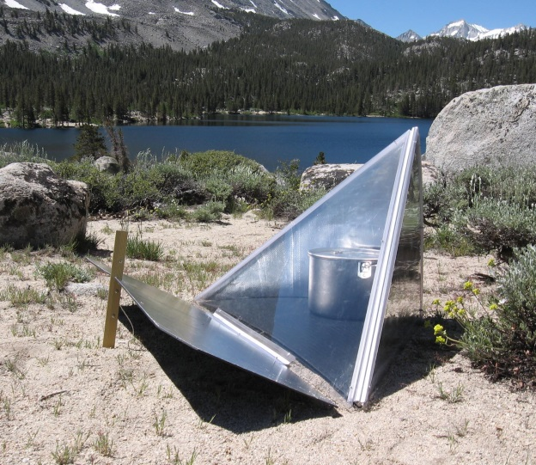
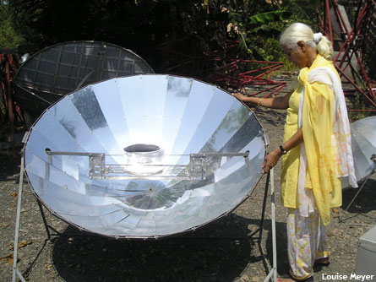
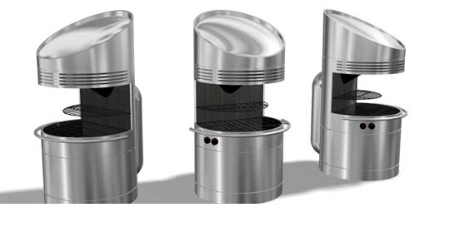
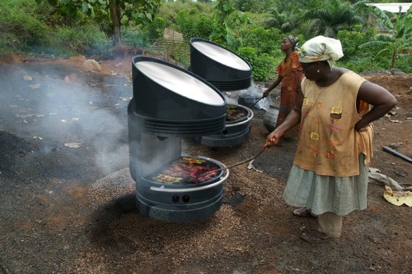
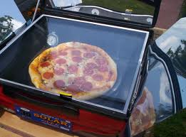
Different solar cookers
Wilson Solar Grill
Current MIT project

