Slide 1
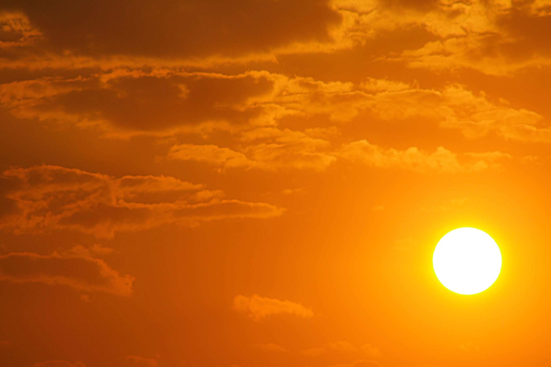
The Power of the Sun

Slide 2
Outline
-What is the sun? -- star (consists of heat - made of)
-why is the sun important to us -- gravitational pull, heat, light, time (concept of calendars?)
- Go into heat --- how does the heat travel to us, seasonal temp and distance to the sun, can harness the energy (solar power)
-Go into light --- amount of light during the day, able to tell time from perspective of sun
-minimal intro of activities
-break out into rooms

Slide 3
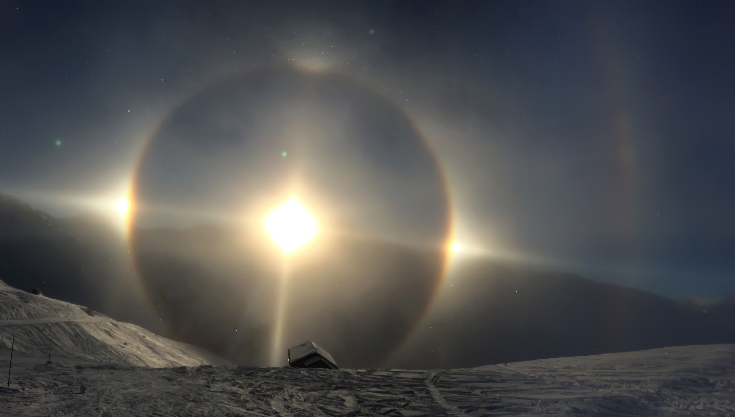
What is the sun made of?
Notes:
Sun is a large ball of gas, mostly made of hydrogen and helium. It stays together because of gravity and is able to keep burning through a process called fusion. That is where two elements are brought together to form a larger element.

Slide 4
Why is the sun important?

Slide 5
Why is the sun important?
Gravity
Heat
Light
Time
Notes:
Gravity - We rotate around the sun and it keeps us rotating around it through gravitational pull.
Heat - the sun keeps us alive through warmth

