Slide 1
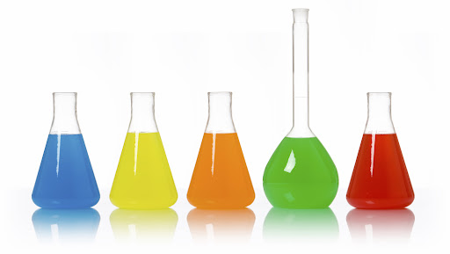
Chemistry
Fall 2021

Slide 2
States of Matter

Slide 3
What is matter?

Slide 4
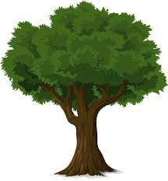
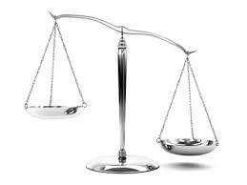
What is matter?
Anything you can touch
Anything that can be weighed

Slide 5
What isn’t matter?

Slide 6
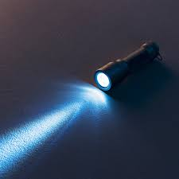
What isn’t matter?
light
sound
ideas
emotions
words

Slide 7
What are the states of matter?
3 main ones

Slide 8
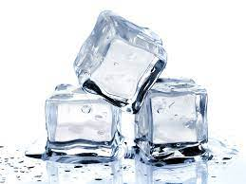
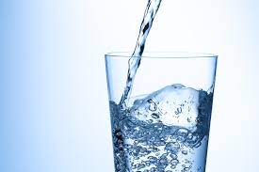
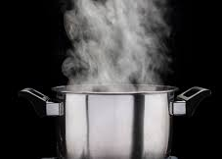
What are the states of matter?
3 main ones
Solid
Liquid
Gas

Slide 9
How does matter change states
Solid
Liquid
Gas

Slide 10
How does matter change states
Solid
Liquid
Gas

Slide 11
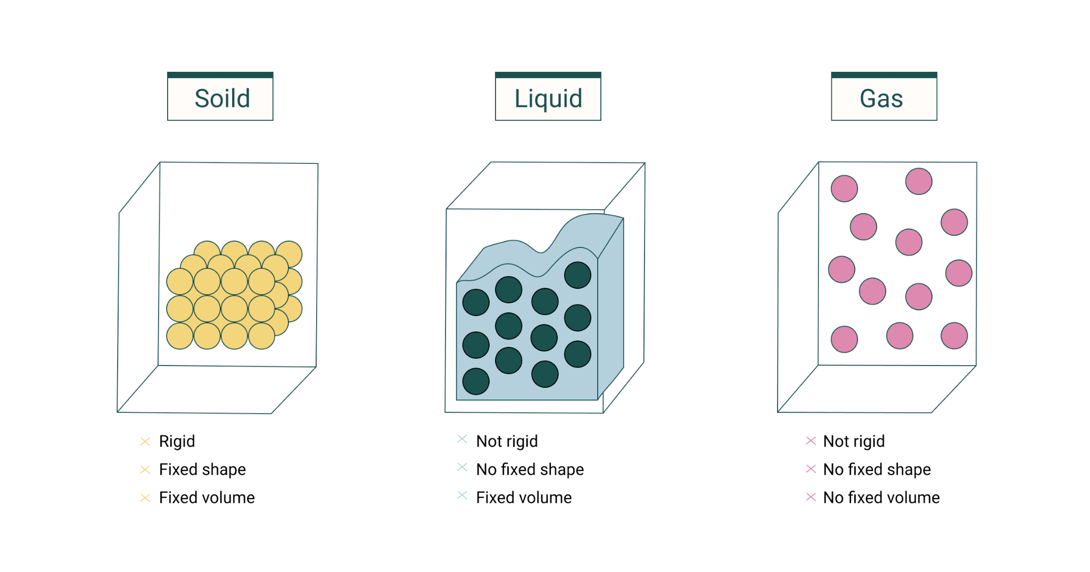
Energy of states of matter
Least energy
More energy
Most energy

Slide 12
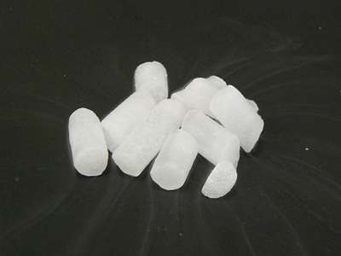
Dry ice inside a balloon
What is dry ice?

Slide 13
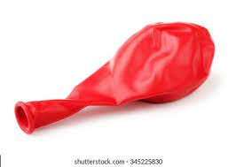
Dry ice inside a balloon
What is dry ice?
What state is dry ice
What do you think will happen if it is put in a balloon?
https://youtu.be/3F7ZNmNd59I?t=13

Slide 14
Post video questions
What happened to the dry ice?
What state of matter did it turn into after sitting in the balloon?
Why did the balloon expand?

Slide 15
What other matter can change states?
We talked about water changing states.
What else can change states of matter?

Slide 16
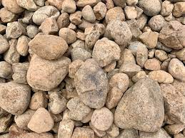
What other matter can change states?
We talked about water changing states.
What else can change states of matter?
What happens to rocks when it changes state
How does rock change state of matter?

Slide 17
What other matter can change states?
We talked about water changing states.
What else can change states of matter?
What happens to rocks when it changes state
How does rock change state of matter?

Slide 18
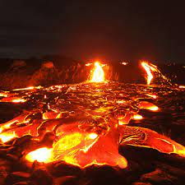
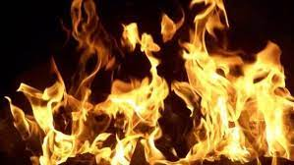
What other matter can change states?
We talked about water changing states.
What else can change states of matter?
What happens to rocks when it changes state
How does rock change state of matter?

Slide 19
Recap of what we’ve seen
Dry ice (solid) to air (gas) when it gets hot
Rock (solid) goes to lava (liquid) when it gets hot
What happens when you mix lava and dry ice?
vs.
https://youtu.be/33Mtww-fogk?t=155

Slide 20
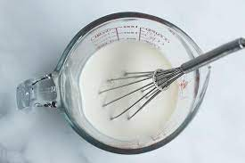
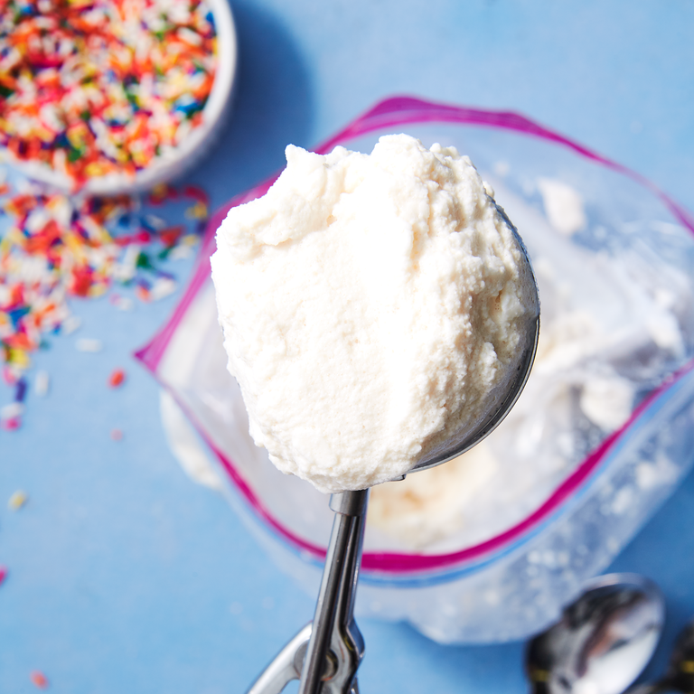
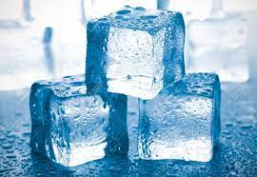
Activity 2: Making ice cream - Pre questions
What type of state change happens when you make ice cream?
What has more energy?
Ice cream mix
Really cold ice
Ice cream

Slide 21
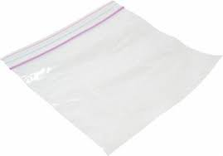
Activity 2: Making ice cream - Make ice cream mix
1 cup half and half
2 TBSP sugar
½ tsp vanilla extract
Try not to keep too much air in your ice cream bag

Slide 22
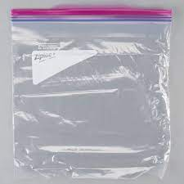
Activity 2: Making ice cream - Make freezing mix
1 cup half and half
2 TBSP sugar
½ tsp vanilla extract
3 cups ice
⅓ cup Kosher salt

Slide 23
Activity 2: Making ice cream - Freeze
Shake bag for ~ 10 minutes

Slide 24
Activity 2: Making ice cream - Final product
Recipe from: https://www.delish.com/cooking/recipe-ideas/recipes/a54721/ice-cream-in-a-bag-recipe/

