Slide 1
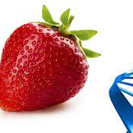
Strawberry DNA extraction
Science Explorers
2023 Food Sciences

Slide 2
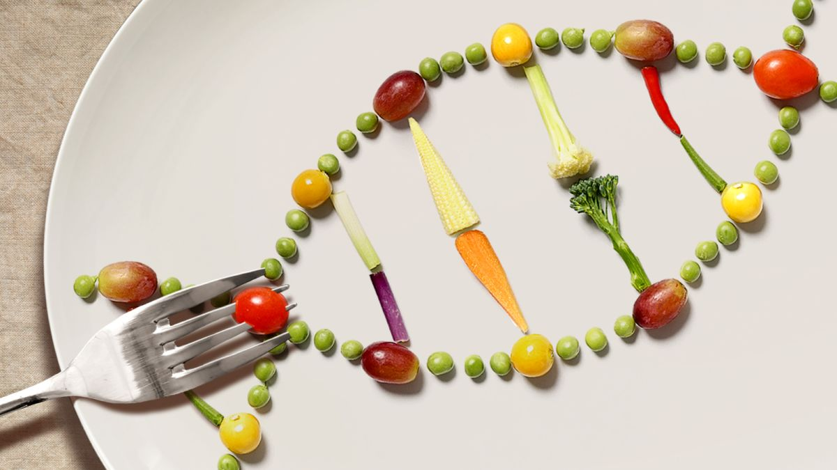
Does food have DNA?

Slide 3
Does food have DNA?
YES! DNA is present in the cells of all living organoids
The process of extracting DNA from a cell is the first step for many laboratory procedures in biotech
Scientist must be able to separate DNA from the unwanted substances of cells gently so that the DNA does not break up.

Slide 4
DNA Fun FACTS!
Each cell contains 9 feet of DNA
In an average meal, you EAT approximately 55,000,000 cells
This is equal to approximately 93,205 miles of DNA

Slide 5
How do we extract DNA from strawberries?

Slide 6
How do we extract DNA from strawberries?
To extract DNA you must remove…
Cell membrane
Cytoplasm
Nuclear membrane
Proteins

Slide 7
How do we extract DNA from strawberries?
Materials:
50-mL tubes with lids and bases
15-mL tubes with lids
resealable plastic bags
wooden sticks
funnels
pack of cheesecloth
transfer pipets
bottle of ethanol, 95% (100 mL)
bottle of liquid detergent
10 g salt (sodium chloride, NaCl)

Slide 8
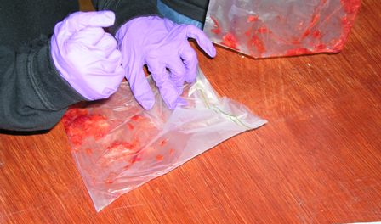
How do we extract DNA from strawberries?
Place the strawberry in a zip lock bag and remove the air
Squash the berry with your hand to begin the process

Slide 9
How do we remove cell membranes?
Cell membranes are made of phospholipids
Phospholipids won’t dissolve in water
What do you use in your home to remove oils from your hands or your dishes?
Soap gathers between oil and water capturing the oil in a bubble called a micelle
When you wash your hands, the soap carries the oils away
By adding a small amount of table salt (NaCl) to the soap solution, the solution can punch holes in the nuclear and cell membranes
The soapy solution also helps removes proteins

Slide 10
How do we remove cell membranes?

Slide 11
How do we remove cell membranes?
Cell membranes are made of phospholipids
Phospholipids won’t dissolve in water
What do you use in your home to remove oils from your hands or your dishes?

Slide 12
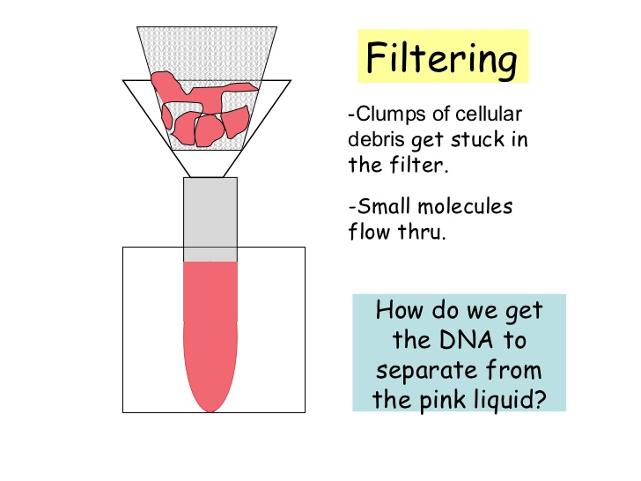
How do we remove debris?

Slide 13
How do we isolate DNA?
To see DNA, it must be extracted or “spooled” from the remaining liquid you filtered.
DNA dissolves in water, but NOT in alcohol

Slide 14
How do we isolate DNA?
The DNA will appear as a white precipitate once the alcohol is added
HOLD THE TUBE by the TOP, not the bottom so the DNA strands won’t fragment from the heat of your hands!

Slide 15
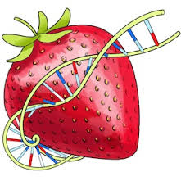
Summary
Break open cells by mashing the fruit
Dissolve organelles and cell membranes with detergent.
Separate DNA from proteins with salt:
Na(+) is attracted to (–)DNA so it bumps off the protein.
Filter out the clumps with a cheesclothe
DNA precipitates in cold alcohol and is spooled out.

