Slide 1
UW Science Explorers
The Science of Foods
March 9, 2023

Slide 2
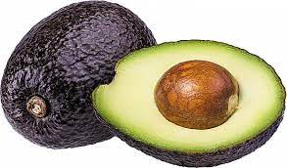
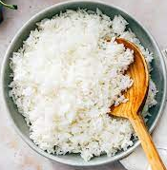
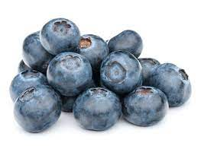
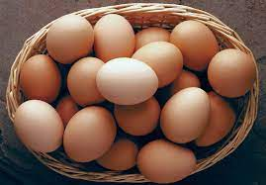
Material properties of foods
Foods can have many different physical and chemical properties that change how, when, and why we use them.
Some foods are spicy or sweet or sour or salty
Foods can also be solid or liquid
A food may change from a solid to a liquid depending on the temperature

Slide 3
What is a solid?

Slide 4
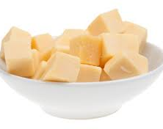
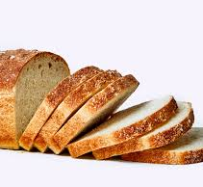
Properties of solids
Rigid
Fixed shape: does not flow to take on the shape of its container (like a liquid)
Fixed volume: does not expand to the size of its container (like a gas)
Very dense
The atoms that make up the solid are tightly bound to eachother

Slide 5
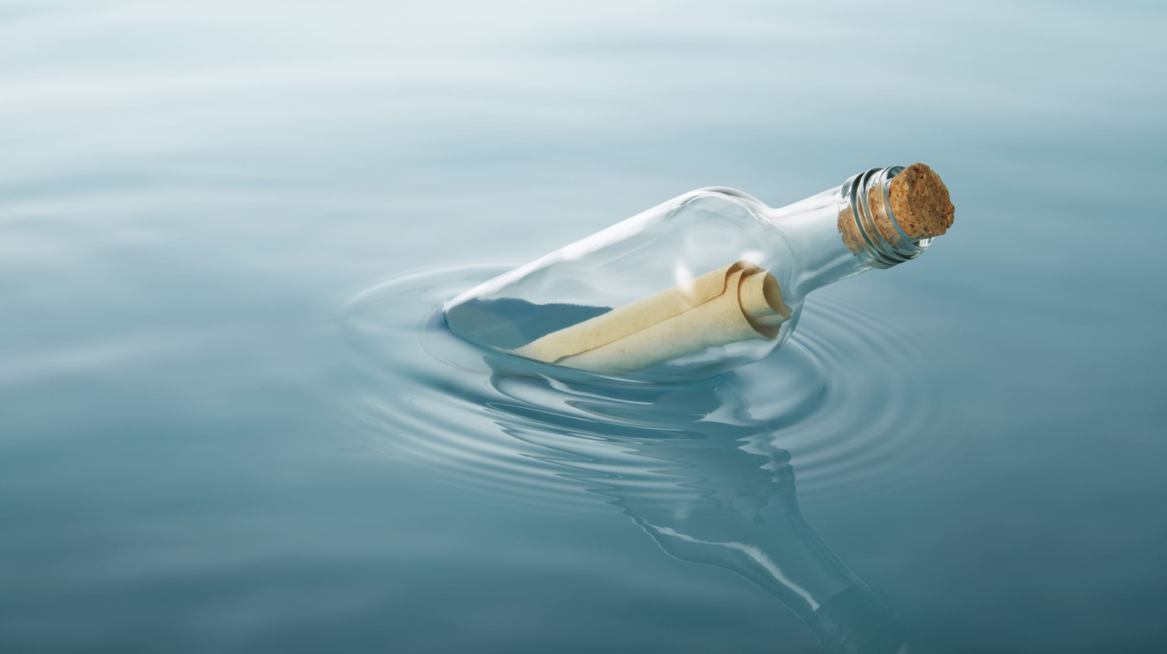
What is a liquid?

Slide 6
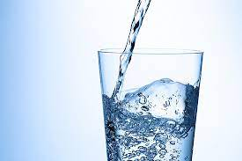
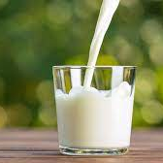
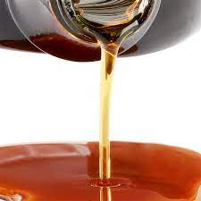
Properties of liquids
Shape can change: does flow to take on the shape of its container
Fixed volume: Does not expand to the size of its container (like a gas)
Medium to high density
Constant viscosity

Slide 7
What is viscosity?
Viscosity tells us how easily a fluid will flow
Water has a low viscosity and flows very easily
Honey and syrup have higher viscosities and flow much slower
Peanut butter has a very high viscosity and flows quite slowly
Source: https://www.sciencelearn.org.nz/resources/1500-viscosity

Slide 8
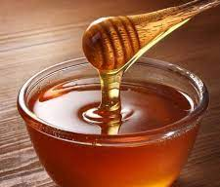
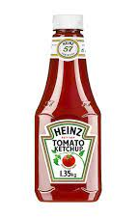
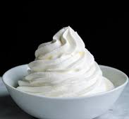
Non-Newtonian liquids
Non-Newtonian liquids change viscosity depending on how much force is applied
What happens if you shake a bottle of ketchup?
If you stir honey for a long time, it becomes more liquid (lower viscosity)
What happens if you whip egg whites or cream for several minutes?
Source: https://www.sciencelearn.org.nz/resources/1502-non-newtonian-fluids

Slide 9
Experiment: making and testing oobleck
Oobleck is a mixture of cornstarch and water that got its name from a Dr. Seuss book.
How to make oobleck:
Measure 2 cups of cornstarch and 1 cup of water into a bowl.
Mix them together by stirring slowly. This is your oobleck.
Tap the surface of the oobleck with your spoon. What happens?
Try rolling it into a ball. What happens when you stop rolling it?
Try stirring it slowly with your finger. Then stir quickly. Do you notice a difference?
Do you think oobleck is a solid, liquid, or a non-Newtonian liquid?

